Slide 1
Corporate Quality Engineering 4Q2013 Calibration Session October 29-31, 2013
Questions or comments, please contact Denise Echols, x41020

Slide 2
Thank You

Slide 3
Good, Bad, Ugly
Good:
- Schedule the audits at adjacent locations in group to save the travel cost.
- Witnessing the testing that Kai trained us on. I think all of the stakeholders involved benefitted from this work.
- FAQ 25 has been very helpful in how to deal with some of these common problems from both the audit and CAR admin perspective. I think it’s working fine as it is.
Team audit approach for larger sites is still working well. I think this year there was more cooperation among the team members to help in the planning, scheduling, and division of responsibilities during the audit, taking some of the load off the Lead Auditor.
- Teamwork – Cooperation among QEs & Site Quality Managers at “benchmark” level.
NBK Audit – Lead auditor partnered with Audit team, Site Quality Manager and Customer(s) far in advance of audit, which resulted in the best run audit I have participated in as a QE. The planning efforts initiated by the Lead along with the monitoring of audit team actions during the audit were keys to the success.
Desk Audits – While recognizing that desk audits always involve auditee interview on some level, the time savings for our customers though reduced interview time is significant. As much of our audit time is spent reviewing records against procedural requirements, I find that I can effectively review records without a busy Engineer sitting across from me. Narrowing interviews to questions and concerns from our previous records review, or in the absence of questions or concerns, asking process knowledge type questions makes for an excellent use of audit time “face time”.
FAQ 25 – Amazing resource that I used many times this year
Jim Kurtz Oracle Reports – Another amazing resource that I used many times this year
CAR Champion Calibration Meetings – 2013 has been the year that we have made the concept of customer focus a key element of every calibration session.
Work-life Balance – Deserves a spot in the Good column again this year. “Keeping our germs at home” in lieu of taking sick days and being able react to family emergencies is appreciated a TON
The amount of support and ease of being able to ask questions of anyone. Ability to observe auditors besides the one I’m training with allows insight in to each auditor’s unique style and technique. Having Auditors/CAR admins analyze the CARs helps in facilitating the ability to write CARs that will be able to be made sense of in the future, that are complete and through to someone who was not part of the audit.

Slide 4
Good, Bad, Ugly
Good:
- The FAQ’s for Global CAR’s is an excellent idea. Not only does it provide specific instructions for how CAR’s related to the issues should be handled by each stakeholder, but they also provide a reasonably good idea of where local Quality Managers can focus their efforts during internal meetings such as ULSFM’s.
- The use of Quality Alerts is helpful in alerting Local QA Managers of the issues that accreditors seem to be focusing on at a given time frame. This helps us get out front on those issues and offers opportunity for Preventive Actions in some cases.
Having multiple auditors at locations where we may have previously on sent one auditor. I think that this cuts down on the time out in the field for each auditor, and it provides opportunities for collaboration on difficult issues identified during audits.
The team work the synergy the technical training.
I would like to see more technical training, one area I would suggest would be in calculations of measurement uncertainty, maybe presented by Bob Florczyk or someone who uses it more regularly.
Also the earlier planning even if it is only a basis for change is good.
- The systems are working very well w/ notifications, knowledge sharing, etc. The site is extremely useful at this point and is a great resource
GCAR Metrics and Data is easily obtainable by QE staff and LQMs, etc. I think it is very well used by our staff.
FAQ 25
CAR Admin Calibration Meetings
FAQ 25 has been very helpful in determining what to do when we have repeat issues. The current structure where each issue links to a “WORD” document has made navigating through the information very easy.
Continue to make sure we allow enough time during an audit for drafting CARs and for conferring and coordinating issues with other auditors on the team.
For multi-day audits, continue to conduct a summary briefing with auditees’ managers at the end of the day.

Slide 5
Good, Bad, Ugly
Good:
- Complicated audits need to have the lead free about 1/2 the day to be able to answer questions from the audit team, to keep abreast of the audit process and issues, and fill in where most needed. This occurred with the Northbrook CAS audit and it worked well. We did not do it with the FUS Audit, and should have.
- Auditing on a team, this enhances learning quickly.
- The Northbrook audit was well managed and agenda had enough time to do a complete audit without feeling frantic.
Alan had time built in so he could manage the audit
Daily wrap-up meetings prevented surprises at the end, we always offer to have them, but in this case, Jim made them available via Lync and sent the invite daily to the managers involved in the audit that day. This seemed to increase participation.
======================================================================================================
Bad:
Witness Testing for CBTL/IECEx/ATEX. In the first couple audits this year we received push-back from the lab staff asking about the requirements and interpretation of the standards. I felt unprepared to give a knowledgeable answer, being armed with just a PowerPoint presentation. Status: There was an issue with humidity chamber verification requirements in IEC60950-1 2.9.2 because of CTL decisions; we stopped auditing after discussion with Karina and Jola
- For the tests to be witnessed in 2014, we need to be better prepared to understand the requirements, possible interpretations, and how to field questions that may arise during the audit. These would include the test methods, equipment, and environment requirements. Status: For 2014 Test, Kai will prepare a FAQ. As we go through these tests in training please ask clarifying questions; FAQ can be updated
Use of the ‘Busy’ sign on Microsoft Lync. A few staff leave the red, busy sign on all the time. When I see that, I take the time to send an email when a quick phone call would be more efficient. (In most recent instances, I have been able to reach these folks via an IM and then find a time to call.) I totally agree and support the use of the Red square when staff are on an audit [ My recommendation would be to encourage staff to only use the red square when they are on an audit, [meeting]or an urgent assignment. Status: Staff be advised.
- Fill the DAP project information manually twice for SNAP DAP audit report for WTDP, TPTDP and PPP programs. It is better to program the forms to auto fill information based on the information from one entry. Currently, it increases the opportunity for entry errors. Status: Will be updated 12/6/13 for use in 2014

Slide 6
Good, Bad, Ugly
Bad:
- Unsure how much GCAR Metrics is used outside of our group – could just be a concern, and not necessarily a bad thing. Would like to see staff (local quality, process/program owners, etc) use the data as well (maybe it is not high priority for them, which is why we push it to them….). It is an excellent tool for our group to use, that is for certain.
Status: I believe we have done a good job of letting people know the info is there; I see evidence of use where staff have saved reports. Not sure what the problem is trying to solve…..
Having the newest person take notes at meetings – I know for me personally that if I’m taking notes, I’m missing the conversation and I won’t be asking questions. This means that I may miss adding things to the meeting and/or miss asking questions that could be beneficial to my understanding of the topic
Status: Discuss at meeting
No audits the last week of the month -- too much push for revenue. One location even asked for us not to audit the last two weeks of the month. That seems reasonable only if it is also the end of the quarter. Status: Discuss at meeting
-- In many cases, due to the re-org efforts earlier this year, we were not provided with the most up to date lists of responsible persons from the Oracle directory, and changes in Dept. numbers and this caused us to assign auditors to the wrong departments for the wrong business units. Perhaps we can encourage local Quality Managers to do a better job of reviewing our scope letters to help ensure that we are scheduling our auditees properly, especially with the recent actions in PS personnel changes. Status: Oracle still may not be updated in a timely manner. Auditors (when there are re-orgs) should reach out to QM’s for updates if changes occur in company after scope letter. If in planning phase auditor should confirm contact info PRIOR to sending scope letter. As I’m made aware of changes, I send out info with the expectation that auditors update their audits.
-The fact that the IEC witness test requirements were not solid and we got a lot of push back form folks who actually did know more than we did. We need to be careful that we are not making up requirements cause someone thought they would be a good idea. Status: I don’t understand this statement. All should know we did not MAKE UP anything. The humidity chamber verification requirements in IEC60950-1 2.9.2 was problematic, can’t promise we won’t have the issue again…call Kai for support; all the training packages are reviewed by technical experts. Don’t expect you to be technical expert or know more than those who do this every day; do you need to be to witness?
=================================================================================================================
Ugly:
How to show the Business Unit impacted/affected for CARs and also in GCAR Metrics – although this may not be something we can control right now. This is currently our only real deficiency in the metrics system. (i.e., where to store the Business Unit in the current CAR Fields, if anywhere) Also, the sector/industry – am unsure how reliable our data is in this category. These are two items to improve upon going forward.
Status: Can’t do anything more with GCAR than the current tool allows. We can’t control industry renaming or BU splitting up……again we do what we can.

Slide 7
Other Stuff
Julie to Lead
To make the audit days (on the spreadsheet) a bit more reflective of actual time:
Have we considered adding 1 day to the excel table for each lead auditor reflect audit prep time and report time.
Have we considered adding one day travel to each audit in North America (Canada, US, and Mexico) and 2 days travel for audits elsewhere to the excel spreadsheet to more closely reflect the audit days.
Perhaps we could cut some travel costs by conducting desk audits of the CAS projects and have a day on-site audit (if going there for lab) to get the questions about the jobs answered. Or questions could be handled via email and phone. It seems that staff are becoming quite aware of the requirements and may not need the face-to-face time as frequently. Another alternative would be to set-up interviews with the project handlers via Lync.
Have we considered creating a calendar where we each can overlay our trips so during the planning phase we can see what other members of the audit team are planning. This could also help when determining who might be available to audit in a last minute crunch. BTW: Using SharePoint this is easy. As far as I know SharePoint does not pull the data from outlook, so it would require double entry.

Slide 8
2014 OSHA SNAP Audits
Continue SNAP audits as we did in prior years
Adding Lab Technical Audits that were done by Bruce Proper’s Team
SOP and Audit Checklist Form
00-QA-J0407 – Lab Scope Review Job Aide
00-QA-F0407 – Lab Assessment Form
01-QA-S0852- OSHA SNAP Audit Procedure- Lab Technical Audits
01-QA-F0852 – OSHA Laboratory Capability Verification
Review requirements of Lab Technical Audit
Witness/talk through test as you do now (If we do CB witness it counts for OSHA as well; but need save as separate form)
No special setup to be requested-look at whatever is in process
No 100 % requirement for coverage of standards for witness/test
Lab Capability (full scope) must be assessed
Lab Capability Report ( see 00-LO-S0480)
Talk/sample other capability information(see form 01-QA-F0852)
Should not add significant time to audit schedules
Checklist form - file title : OSHA SNAP Lab Form (audit report number)
At end of SNAP Lab Tech Assessment should upload 2 forms as one attachment ( 01-QA-F0407 and 01-QA-F0850)
Need OSHA approval to start
Follow-up in Jan 2014 if any changes/refresher

Slide 9
2014 Audits General
Draft Audit Schedule
Updates will be needed once feedback from stakeholders received
Need updates: Desk Audit of CPO required; desk audits of doc reviews when needed
Updates will be needed as organization changes are occurring ( plastics to PS @ STR Enfield)
If issues with staff conflict let me know
Let lead auditors know of vac/religious holiday’s/etc
With re-org, make sure contact info is correct; should check again before audit especially if re-org
ISO 17065 requirements/rescheduling process(review process in place)
2013 schedule should be considered under ISO 17065 requirements
See 00-QA-S004 for approval of schedule change requirements
Want to meet with leads to refine audit days; looking at possible reduction of time based on risk assessment. For example: NBK instead of 2 week audit all labs/CAS, look at 3-4 labs/CAS all elements(still have to audit labs with individual accreditations)- completing all labs over 3 year period UNLESS issues or major changes occur. – LEADS: Please Set Meetings with me Nov-Dec
Audit Scopes
Look at scope of audit (locations, industries, etc) - Can’t do ALL in one audit; review sample sizes; complexity of audit….will review with leads when we refine audit days
Don’t just re-audit what was done previous year unless there were issues(process audits) MEANS U HAVE TO LOOK AT PAST REPORT/TALK PRIOR LEAD
Look at all roles/responsibilities
Ex: PDE- PDE inventory; L3 Qualification, datasheet review, standards updates, etc

Slide 10
2014 Audits General
Accreditation Information on IQA Website
Local Quality will start to maintain accreditation information on SharePoint
Greater China: http://intranet.ul.com/bu/ps/GCQuality/Lists/Scope%20of%20Accreditation/AllItems.aspx,
IQA accreditation info on website will go away
Need to ask LQM’s for accreditation info in audit planning to update audit details/scope

Slide 11
2014 Audits General
General Audit Stuff - Feedback from NBK Post Mortem
Keep Doing These Things: GREAT JOB!!!!!
- Start planning early.
- Make the schedule front-loaded to allow time for the auditors to follow up on items later in the week.
- Incorporate the availability of auditees into the audit planning.
- Send reminders to those scheduled to be audited the day before they are scheduled.
- The daily briefings continue to be online meetings with invitations sent to those scheduled that day.
- Schedule time between the audit completion and closing meeting to give the audit team time to complete the CARs before the closing meeting.
- Send links to the CARs (or instructions how to get them) prior to the start of the closing meeting to allow time for review.
- Hold a CAR Owner Workshop after the audit for the new CAR owners.(Quality Manager)
- Northbrook staff should be as supportive of future audits as they were of this one, especially considering the Engineering audit took place during the last week of the quarter.

Slide 12
2014 Audits General
General Audit Stuff - Feedback from NBK Post Mortem
Make these adjustments:
- Future audits should not be scheduled during the last week of the quarter and should avoid the last week of the month. Suggest scheduling the lab portion for the second or third week of a month.
DLE Comment: Thanks for the feedback, timing is not always up to the audit team. Those we work with have input, as well as availability of staff. Can’t make promises in this area Understand
- Send the audit details to participants earlier if possible.
DLE Comment: Jim is this our details or yours? This is Jim’s responsibility.
- When checking for staff availability, also verify that the lab will have work on the planned audit days.
- When the audit team creates the schedule, make sure the headings are displayed on all pages of the schedule.
DLE Comment: Jim …Not sure what this is referring to The audit schedule had a table the spanned several pages, but the heading of the columns was only on the first page. I’m recommending they have it on each page.
- More granularity for the audit schedule, perhaps 1 or 2 hour blocks instead of half days.
DLE Comment: Jim not clear what this means please clarify This year, we assigned schedule blocks by half-days. Next time, we want it in one or two hour blocks.
- Create a project list prior to the audit, and have the auditors select the projects to be audited.
DLE Comment: Not clear auditors. There is project review started prior to the audit. What was needed/selected during the audit. Engineers didn’t want to select projects, they want the auditors to select them, like is done for ANSI web audits. I can provide the project list next year for the auditors to use to select projects.

Slide 13
2014 Audits General
General Audit Stuff - Feedback from NBK Post Mortem
Make these adjustments:
- Have maps of the lab locations available for the audit team.
- Schedule the Combustion Lab considering that staff may be in another location.
- For the test witness portion, suggest opening a project in LPM so that meter use can be used to log the equipment used.
- To reduce waiting time, the test witness portions should be scheduled for a specific time and place and needs to include both the lab technician and engineer.
DLE Comment: QE’s was this on an agenda and scheduled? This was scheduled in a half-day block, I believe. The engineer didn’t show up until 30 mins later, so we want to schedule this at a specific time next year.
- Send CAR links to ALL participants prior to the closing meeting, and not just to the suggested owners.
- Perform the audit retrospective at the end of the closing meeting.

Slide 14
2014 Audits General
General Audit Stuff - Feedback from NBK Post Mortem
Consider making these changes:
- Only provide the link to the schedules in the notification emails. Do not include the schedule in the text of the email.
- Consider holding the opening meeting as an online-only Lync meeting.
DLE Comment: Can make on-site and Lync; not just Lync only. We had it as both Lync and Conf room T, but it seemed it could have all been done online.
- Audit project records prior to the on-site portion to reduce the time impact on staff.
DLE Comment: Not clear auditors. There is project review started prior to the audit. What was needed/selected during the audit.
- Auditors should provide information about their background when meeting auditees.
DLE Comment: If this is something wanted, a brief summary can be done in opening meeting. Auditors are not going to get interviewed in the opening meeting. Something high level. Auditing x years, worked UL various areas, etc. 2 minute overview That would work – we had this feedback from someone who thought this would be helpful to those being audited.

Slide 15
2014 Audits General
General Audit Stuff - Feedback from NBK Post Mortem
Consider making these changes:
- Highlight the witness test qualifications of the audit team.
DLE Comment: Not sure if this is an isolated individual question or a general thought. Jim we can get something together for general purposes but we are not going to provide training records, etc. We receive training, training material and trainer approved (for example by Jola W, IECEE Assessor and CB Program) Agree – as we discussed.
- Prior to allowing staff to “just take care of issues” found during the audit, first review the corrective action status of open relevant CARs.
DLE Comment: QE’s/Jim please clarify There were some items that the auditors allowed to be ‘corrected’ and not written up. In my discussion with the audit team, we thought it would be good to mention that we should review the open CARs before doing this, as it could indicate that completed corrective actions were not effective.
- Encourage Engineering Leads to be present when the engineers are being audited.
- More sharing of ‘better practices’ that the audit team has seen at other sites.
- At the close meeting, provide a summary of the audit (number of projects audited, areas covered, etc.) before jumping into the nonconformances
DLE Comment: Jim: Is this a rehash of daily wrap ups? Could give high level went to this lab, etc. Reviewing which projects - not at closing meeting unless there was an issue. This was Joe’s suggestion.
- Create a survey to audit participants to capture their audit experience and feedback for improvements.
DLE Comment: Thought that was why retrospective was put in place. Jim do you want to support another survey. FYI we conduct random survey’s after some audits for feedback. We discussed this as a way to get more audit feedback beyond the retrospective.
- It was suggested that coffee and water be available for the audit team and those being audited.
DLE Comment: Sorry, not in the budget Awwww.

Slide 16
2014 Audits General
General Audit/QE Stuff –with linkage to CBS
Customer Focus
Respond to request at least 24 hours- even if it’s to get a date for completion; if away set out of office with contact
Help when/where we can
Offer solutions not just service( work with LQM, direct to process manager, facilitate meeting, etc)
When needed ask Mel, Kai, Cheryl, DLE for support
Be cognizant of staff time ( desk audit/Lync)
Audit/CAR meetings (agenda/summary)
Let CAR Owners know of resources Roger Lytle (TCD reports)
Send links to reports we use from Jim Kurtz to help with analysis or verification
Stay focused on audit - don’t derail; socialization at lunch/breaks
Audit time planning/scoping audit (don’t try to fully audit ALL industries & ALL locations in one audit)
Sense of Urgency
Scope letters, reports, etc on time
Being prepared and on-time for meetings
Completion of CARs, ready for closing meeting

Slide 17
2014 Audits General
General Audit Stuff – Input from IQA and CBS
Business Results
Clear CARs ( requirements clear, objective evidence( sample size, project numbers, etc)
Pathnotes – show areas of required coverage( Programs, Energy Star, NVLAP, OSHA SNAP, etc)
Notes on website/audit details(remember all can see, need to be clear, professional)
Lunch brought in to site/eat site @ cafe when possible ( save time)
Dinner of others (outside of the assigned audit team ).
1 night ok to take local quality manager out to a reasonable dinner
Any others only with prior approval
Communication/Collaboration
See NBK Post Mortem
Lead w/ Audit Team (before and during audit) and LQMs very important
Current/previous lead auditor

Slide 18
CAR
Observation or Finding?
Is this CAR clear?
Requirement vs nonconformance vs objective evidence - ok?
Nonconformance clear?
What’s missing?
Sample size?
Information to justify test/evaluation issue as observation?
Linkage to Global CAR justifying Obs?

Slide 19
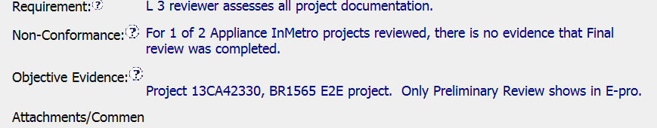
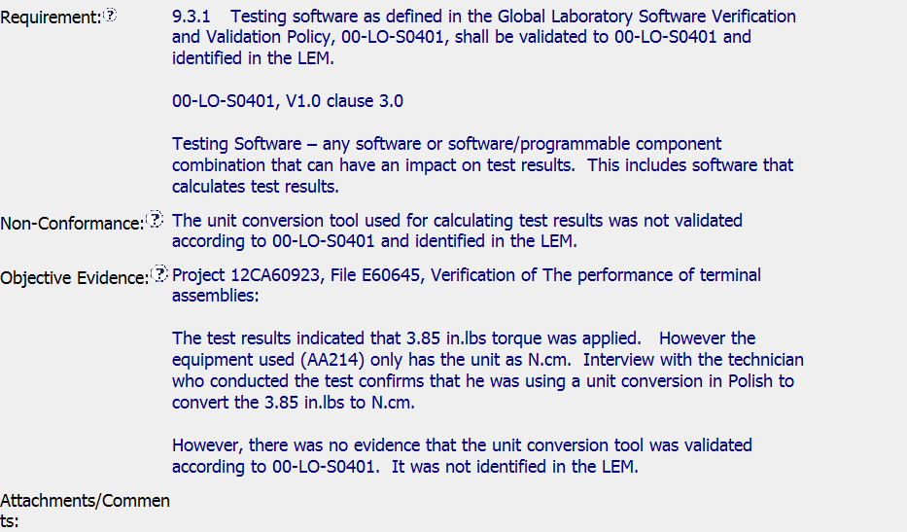
1
2

Slide 20
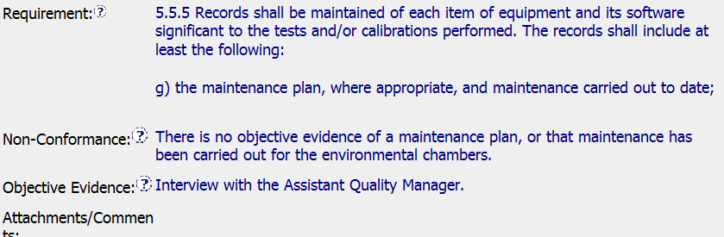
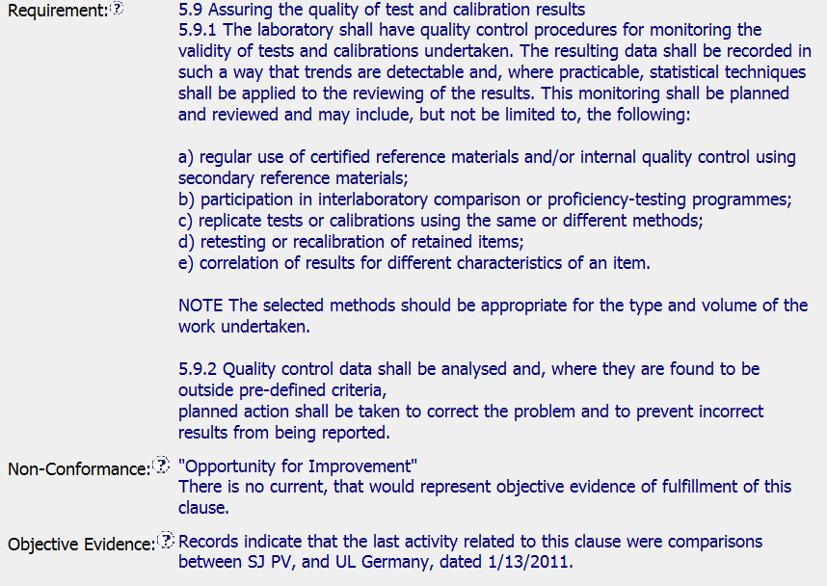
3
4

Slide 21
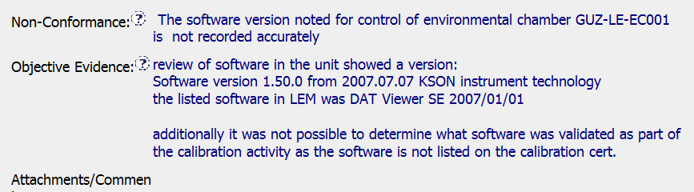
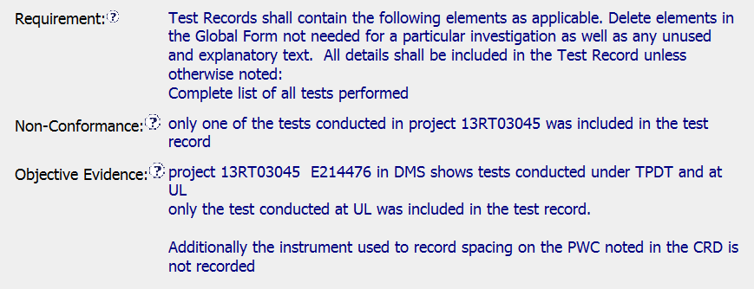
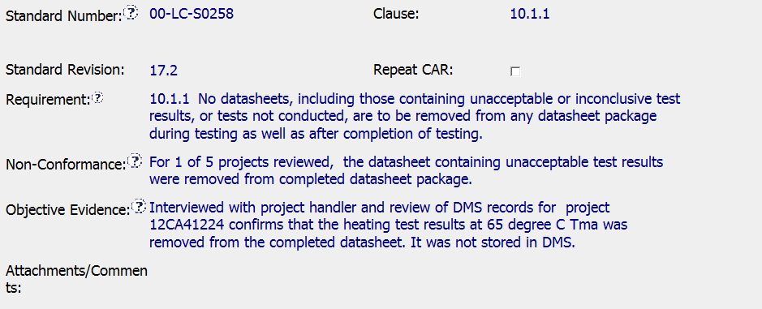
5
6
7

Slide 22
Wrap -Up

